Slide 1
Lecture 28: Strategies for Transition towards
Value-based Life and Profession
(Humane Society)

Slide 2


Slide 3
Recap
At this concluding stage, it is appropriate to recapitulate the core message of this course and then to visualise the steps that each one of us can take for transition from our present state towards a holistic, fulfilling way of life towards humane society (universal human order).

Slide 4
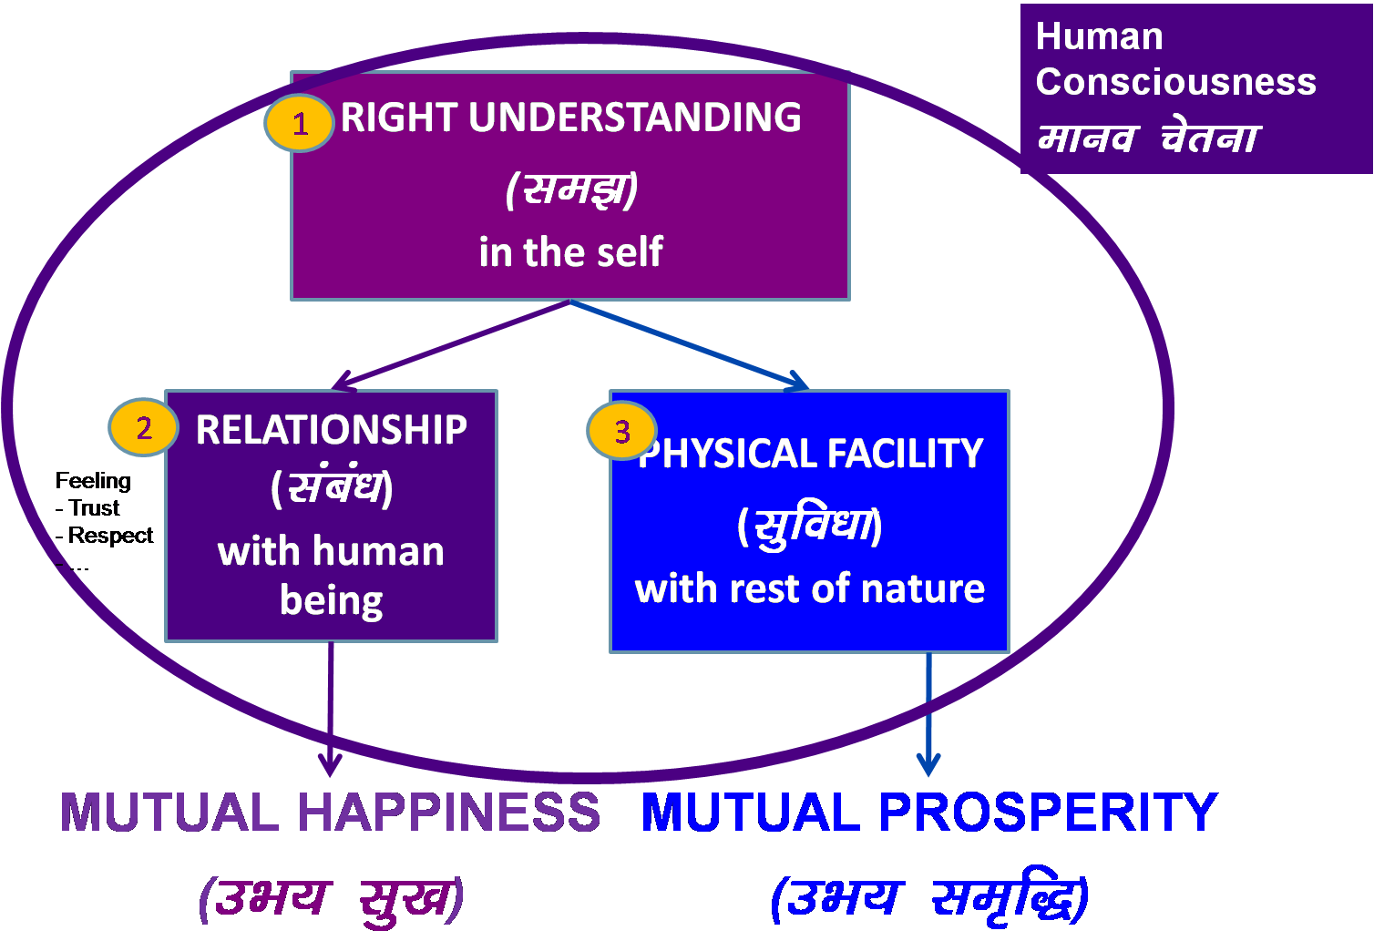
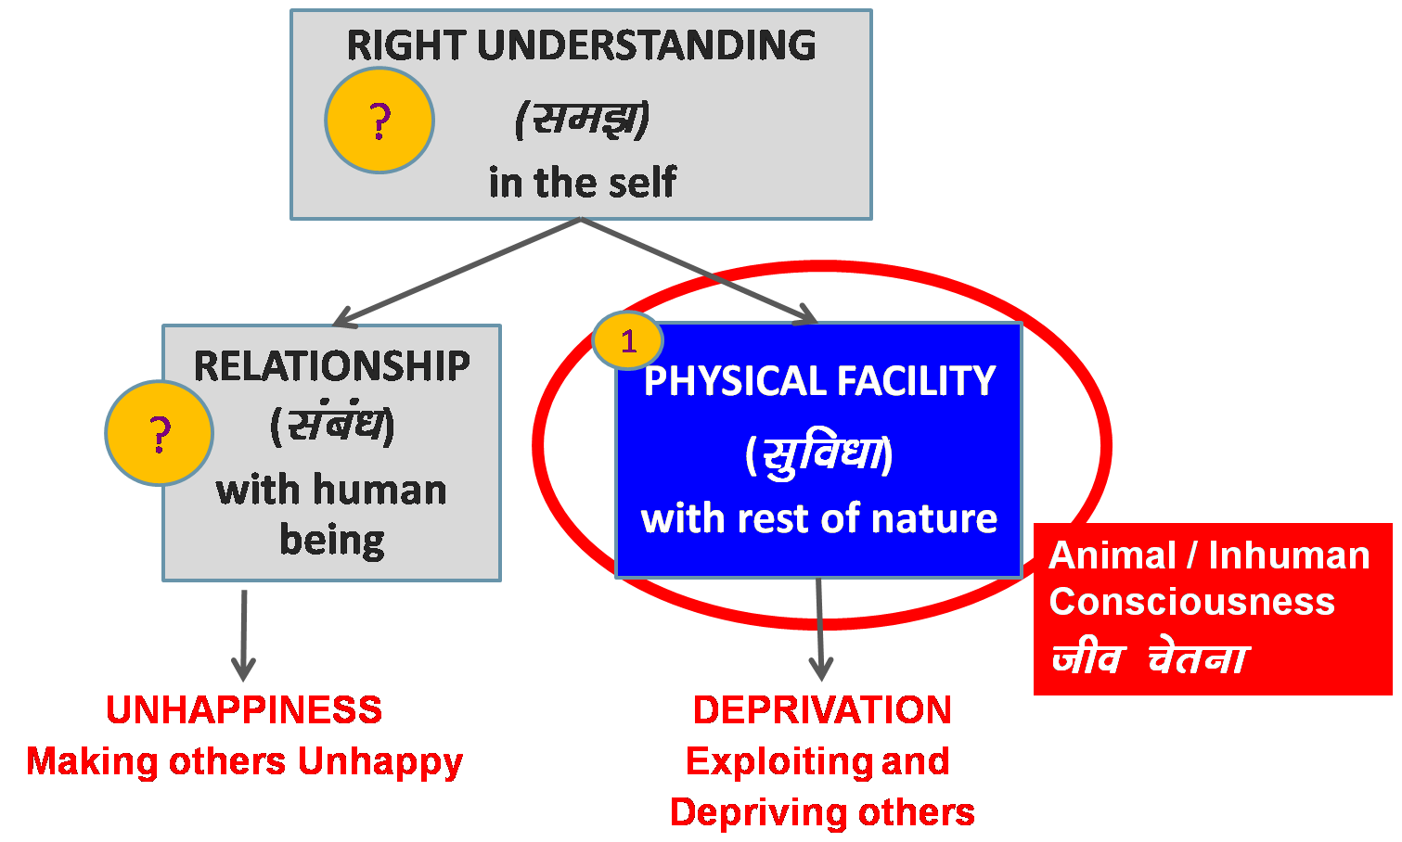
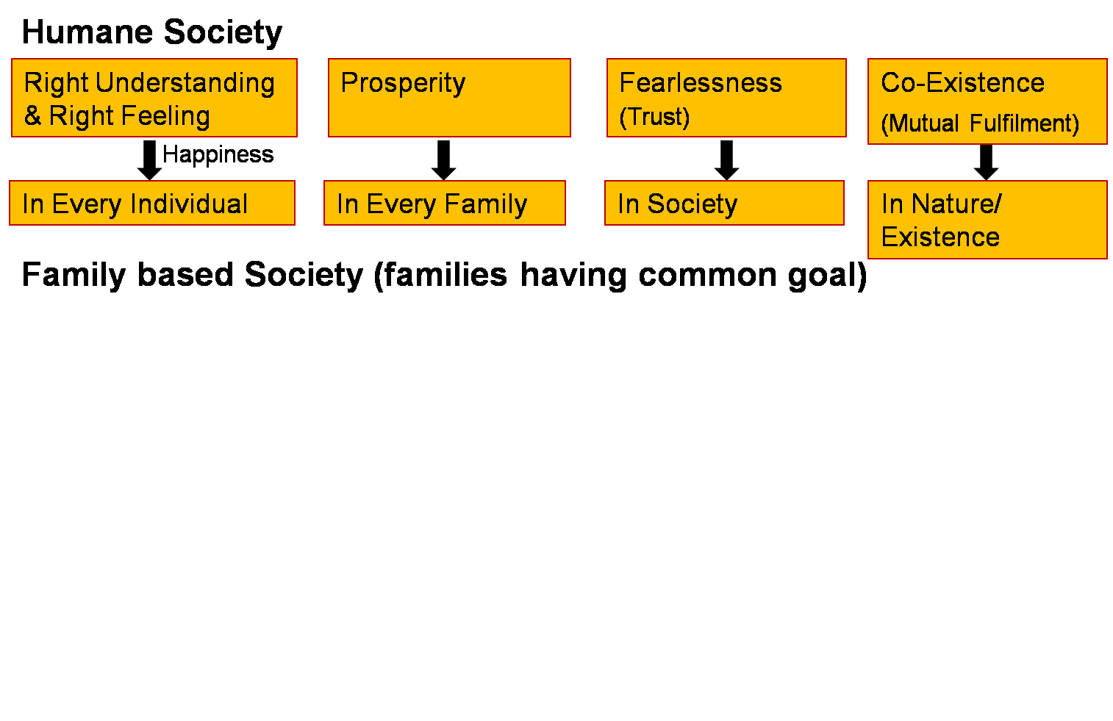
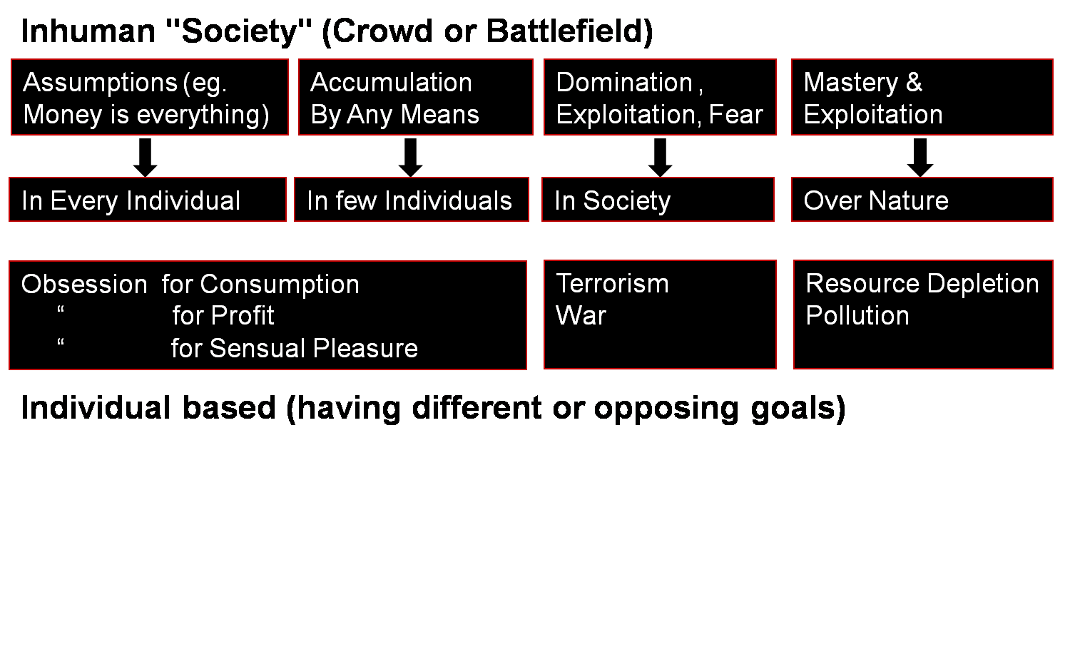
Human Education
Human Consciousness
Human Values
Human Conduct
Humane Society
Transformation& Progress
laØe.k&fodkl
Overall Transformation
  In the individual
  In the society

Slide 5
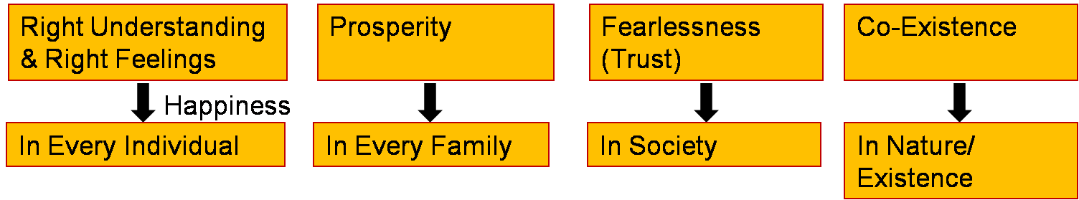
Steps Toward Humane Society (Universal Human Order)
People’s Education Program: for adults
Education-Sanskar Program: for children
Humane Society- Undivided Society, Universal Human Order Program
Just as a seed replicates itself, so the vision of an Undivided Society and Universal Human Order can be evidenced on this planet…
Family – Family cluster – Village – Village cluster ... Nation ... World Family
~10¹ ~10² ~10¹⁰
10 yrs 1
Next 10 yrs 10
100 yrs 1000 cr
People with Right Understanding & Right Feeling
Parents - Policy Makers
Teachers …
20-50 yrs
People with Right Understanding & Right Feeling
- People with definite Human conduct, the competence to participate in Universal Human Order
10-20 yrs
Fulfilment of Human Goal

Slide 6
The Core Message
To be able to fulfil the basic human aspirations i.e., happiness and prosperity and their continuity, it is essential to gain the right understanding – the understanding about oneself vis-a-vis the rest of existence, the understanding about continuous happiness and prosperity.
This involves the realization that there is an innate harmony at all levels of existence. In fact, the whole existence is co-existence.
It is the essential purpose of human beings to understand this harmony and co-existence (co-existence, harmony and relationship ) and learn to live in accordance with it and be fulfilled.
It thus leads to:
  Individual transformation – from animal consciousness to human consciousness and
  Societal transformation – from inhumane society to humane society

Slide 7
Steps for Transition
Step 1: Steps for Individual Transformation
Step 2: Creating Mass Awareness towards Holistic Development & Human Education
Step 3: Moving towards Human Education- Humanising the Mainstream Education
Step 4: Developing Models for Holistic Living in Educational Institutions
Step 5: Developing Models for Humane Society- Holistic Living in the Community
...
Step N: Developing Models for Humane Society- Holistic Living at the level of World Community

Slide 8
Step 1: Steps for Individual Transformation
1.1 To verify the proposals on your own right, i.e. on the basis of your natural acceptance and on the basis of your experiential validation.
Self-exploration
1.2 To be aware of yourself, of your imagination (desire, thought and expectation) every moment. With this awareness, you will know the content of your imagination and also of all the accumulated acceptances which are your sanskar.
Self-awareness
1.3 Now, with the awareness of your imagination, of your sanskar, the third sub-step is self-evaluation – to evaluate your sanskar vis-à-vis your natural acceptance; and making it in line with natural acceptance
Self-evaluation; and Self-evolution
Recall that
sanskar (t) + environment (t) +self-exploration (t) →sanskar (t+1)

Slide 9
Step 2: Creating Mass Awareness towards Holistic Development
With the right understanding and right feeling in you, you will develop the willingness and capacity to share it with others.
Through sharing, you are facilitating and developing other people to have the right understanding, right feeling and right thought.
It can be in the form of informal disussion and formal workshops.
The people to share with would include among others:
  Family members and friends
  People who have interest and readiness for purposeful social effort and social development
  Teachers, educators, education administrators and parents
  Policy makers- People connected to governance
  Your colleagues at work
  To start with, it is important to share with those who are already willing to listen. Ii is better to start this sharing once you have done sufficient work on yourself, only then people will be able to accept you as a living example and take inspiration from you

Slide 10
Step 3: Moving towards Human Education- Humanising the Mainstream Education
3.1 Integrating appropriate inputs of value education at various levels in the current curricula from school education to higher education.
3.2 To effectively proliferate the above effort, requisite support and policy initiatives by monitoring agencies, such as AICTE, MHRD, UGC, ICMR, University Academic Councils and School Education Boards will be helpful.
3.3 Further, it will be essential to introduce teacher orientation programs (faculty development programs) and development of resource material to implement the above suggestions at a large scale.
3.4 The next sub-step will be to provide adequate thrust to R&D dedicated towards transforming the whole mainstream education into humanistic education (value-based education). This is going to be a long-drawn process. However, it is indispensable.

Slide 11
Step 4: Developing Educational Institutions as Models for Holistic Living
It is important to Develop Educational Institutions as Living Models for Holistic Development, for Humane Society
This will also necessitate linking the educational institutions with local development programs in collaboration with voluntary organizations and government agencies.
Accordingly, the focus of R&D in higher education institutions will need to be shifted towards various aspects of holistic development, resulting in the development of real-life models facilitating universal human order.

Slide 12
Step 4: Developing Educational Institutions as Models for Holistic Living
It is important to Develop Educational Institutions as Living Models for Holistic Development, for Humane Society
This will also necessitate linking the educational institutions with local development programs in collaboration with voluntary organizations and government agencies.
Accordingly, the focus of R&D in higher education institutions will need to be shifted towards various aspects of holistic development, resulting in the development of real-life models facilitating universal human order.

Slide 13
Step 5: Developing Models for Humane Society- Holistic Living in the Community
It has been already discussed in the last session
We need to develop the model for humane society at different levels
We have to start with the community (at the village level for example) with around 1000 people and around 100-150 families
Ultimately, we have to go upto developing the model for world family level

Slide 14
Step N: Developing Models for Humane Society- Holistic Living at the level of World Community
Step 5 has to be extended upto the level of World Community

Slide 15
Step 3: Moving towards Human Education- Humanising the Mainstream Education
Step 4: Developing Models for Holistic Living in Educational Institutions
Steps in Implementing
Human Education at the level of Institution (University)

Slide 16
Key Steps for Change: Initial Steps in Implementating Holistic Human Education
Step 1: Value Education मूल्य शिक्षा
Incorporating values in existing curriculum
Incorporating case studies of harmonious living: Cases from local Culture, Civilisation, Knowledge System. e.g. Local, regional, Indian culture, civilisation – Indian Knowledge System (IKS)
Incorporating practice in Skill Development
Step 2: Value Based Education मूल्य परक (संस्कार आधारित) शिक्षा
Organising the whole curriculum on the basis of values, for living in harmony
Holistic and Value-Based and Practice Oriented and Integrative Skill Development
Step 3: Value Based Living मूल्य परक जीना (मानवीय संस्कृति पर आधारित)
Practice of living in harmony, harmonious behaviour, work and
participation for harmony – in family, institution, society… nation… world

Slide 17
Steps Towards Human Education in an Institution
Step 1: Introduce/strengthen Right Understanding in the academic curriculum of the university / institute (along with existing courses)
1.1. Foundation course
1.2. Higher level courses
1.3. Elective courses
1.4. Social projects, socially relevant final year projects
1.5. Social internship
+ Weekly meeting
+ Reaching out to all faculty, staff, students… community…
Extensive Mode – Bring the proposal to teachers, staff, students… all

Slide 18
Current Status
The foundation course is a part of the academic curriculum of more than 40 universities in India and Bhutan
  - Technical universities - Medical universities
  Agriculture universities - Other universitiesnow
Now, for all the professional colleges under AICTE, India
Higher level courses are offered by several of the universities
  e.g.
  Understanding the Human Being Comprehensively
  Understanding Co-Existence in Existence and its Manifestation
  Values, Relationships & Ethical Human Conduct
  Holistic Development towards Universal Human Order
Elective courses are offered by some of the universities
  e.g.
  Political and Economic Thought for a Humane Society
  Management by Relationship
  Social (Human) Enterpreneurship

Slide 19
Learnings and Challenges
Learnings:
Universal human values are teachable, can be taught
Self-exploration is effective
Challenges:
Management Involvement & Support
Commitment and Preparation of Teachers – Understanding the existential reality & living accordingly
(starting with oneself)
3. Environment in colleges & society (not conducive – promotes indulgence competition etc. rather than right utilization and co-operation)

Slide 20
UHV: Proliferating in a Natural Manner…
2005 IIIT Hyderabad (AP) – an experiment
2006 IIT Kanpur (UP) – an experiment
2009 UPTU (now AKTU) – large scale experiment [ 800 C]
2011 IKG-PTU (PB) – a high speed, large scale experiment [ 400 C]
Encouraging results
2012 HPTU, Hamirpur (HP) [ 46 C]
2013 JNKVV, Jabalpur (MP) [ 6 C]
2013 Collegiate Education, Andhra Pradesh (17 univs) [2500 C]
Galgotias University, Greater Noida [ 3 C]
2014 Atmiya Group of Institutions [ 4 C]
2015 IIT (BHU), Varanasi [ 1 C]
2016 Adesh (Medical) University, Punjab [ 5 C]
4000+ Colleges in 40+ Universities in 9 states in India,
All professional colleges under AICTE, India
2013 Royal University of Bhutan [ 8 C]
2015 Khesar Gyalpo University of Medical Sciences [ 3 C]
All Colleges of Higher Education in Bhutan

Slide 21
Steps Towards Human Education in an Institution
Step 2: Establish streams of Value Based Education at the university / institute
UG & PG diploma / degree programs in value based skills
based on Holistic Development with well-being of all in the centre
- Technology - Management
- Social Science - Economics & Finance
- Political Science - etc.
E.g. at IKG-Punjab Technical University offered
  1 Year PG Diploma in Universal Human Values & Professional Ethics
  2 Year M tech in Holistic Development, Systems & Technologies
Beginning of Extensive Mode – Develop resource persons...

Slide 22
Steps Towards Human Education in an Institution
Step 3: Develop Value Based Living at the institute
Value based living = living on the basis of right understanding
3.1. Education – Holistic Human Education (Values + Skills)
3.2. Mutually fulfilling behaviour – Justice
3.3. Health education
All education, pre-primary-12, UG & PG diploma / degree programs
based on Holistic Development with well-being of all in the centre
Mutual happiness or justice in human-human relationship
No domination, no exploitation of human being
e.g. Institutions making effort to be a living model
  Colleges, like AKG, Gaziabad affiliated to AKTU, Lucknow

Slide 23
Steps Towards Human Education in an Institution
Step 4: Develop Value Based Living at the institute
4.1. Preservation
4.2. Self sufficiency
Self-sufficiency of the institution through cyclic & mutually enriching production activities and take such activities to a scale where the needs of all the faculty, staff and students are fulfilled within
Mutual prosperity in human-rest of nature relationship
No exploitation of rest of nature

Slide 24
Steps Towards Human Education in an Institution
Step 5: Develop the institute into a Nodal Center for the local community
5.1. Share and promote value education and value based education
5.2. Share and promote value based living
e.g. 10 nodal centres at AKTU, 5 nodal centres at BTU, IRC-UHVE IKG-PTU
CLCS, Royal University of Bhutan, 3 nodal centres at VTU… are making
effort
Step 6: Develop the institute into a Regional Resource Centre in collaboration with other nodal centres
Step 7: Develop the institute into a National Resource Centre in collaboration with other regional resource centres
Step 8: Develop the institute into a Global Resource Centre
8.1. Programs for ensuring Human Education at the world level for realising Human Society- Undivided Human Society and Universal Human Order

Slide 25
Step 5: Developing Models for Humane Society- Holistic Living in the Community
- A Holistic Community Model
(already discussed in last session)

Slide 26
Key Takeaways
To ensure happiness and prosperity and their continuity for all human beings, the transition to human consciousness and humane society is essential.
This requires a dedicated effort to implement at a mass scale, the humanistic education focusing on right understanding.

Slide 28
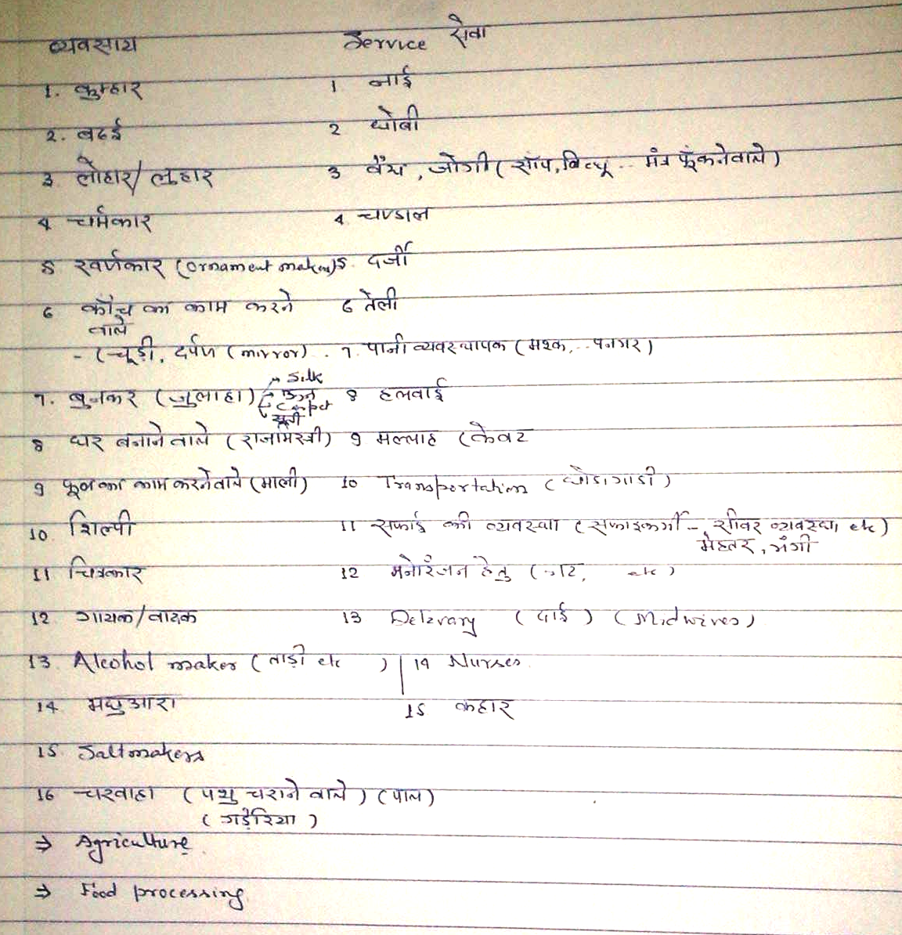
Some skills / occupations required for a village to thrive

Slide 29
Vision and Strategy for Integrating
Universal Human Values in Technical Education System Comprehensively
Proposed by Prof. RR Gaur, chairman NC-UHV, AICTE, 13th Dec 2019

Slide 30
1. Launching of UHV based SIP
UHV FDPs, workshops, implementation and monitoring of the scheme etc.
2. Introducing UHV-II as Mandatory Foundation Course
Action on the part of AICTE; motivating management and heads of institutions; Teacher preparation – 8-day residential FDP essential; those teachers who have undertaken 8-day FDP in connection with SIP may be motivated to teach this course; further FDP workshops need to be organized for other teachers; online help may be made available to new teachers;
The course material is well-developed and extensively tested – revised text book and teachers manual, website available.

Slide 31
3. Facilitating Teachers for this new course
Guidance on evaluation
A refresher course essential after going through the teaching of the course once or twice – arranging workshops for conduction of the refresher course
4. Creating Conducive Environment in the Institution for Assimilation of UHV
Initiating Value Education Cell; appropriate extra-curricular activities; special lectures; orientation of other teachers/mentors
5. Planning Follow up Activities and Regular Mentoring
Exposure to the present social reality – interaction with appropriate NGOs; Socially relevant projects, reorienting hostel activities etc.

Slide 32
6. Further Academic Inputs – introduction of Elective Courses
Direct applicational courses such as:
Professional Ethics, Management by Relationship, Holistic Technologies and Systems, Sustainable Development, Social Entrepreneurship etc.
(b) Courses on Indian Cultural/Philosophical Heritage
(c) Traditional Technologies and Systems
7. Post Graduate Programmes for Comprehensive Teacher Training in UHV and Design of Holistic Systems
One year PG Diploma in UHV
Two year M.Tech. Programme in Design of Holistic Technologies and Systems

Slide 33
8. Initiating Centres of Excellence for Development of Model Curricula for Technical Education in the Light of UHV, Dev. of Resource Material and Resource Persons, Applicational R&D for Living Models

